Slide 1
Menstrual & Hygiene Waste Management
Dr. Shyamala Mani,
Sr.Advisor, CEH, PHFI and
Visiting Faculty, BBA FHM, DSEU

Slide 2
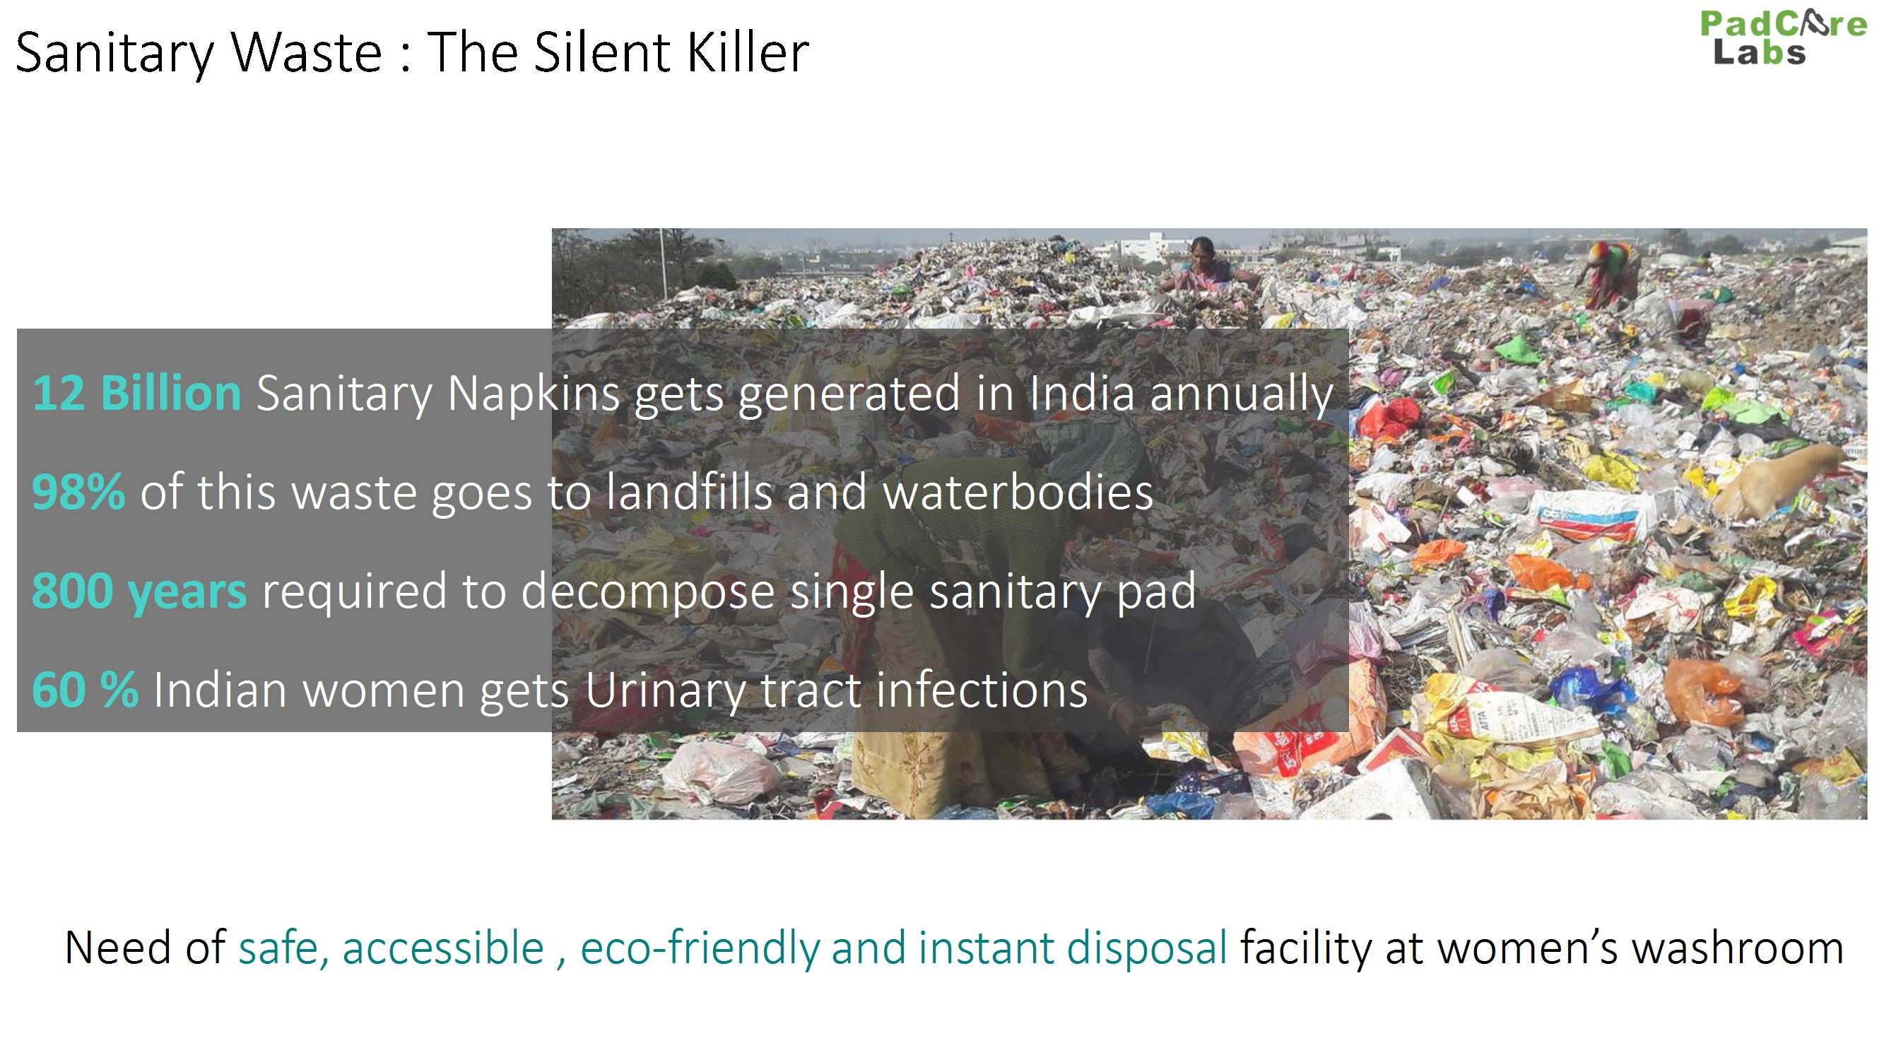


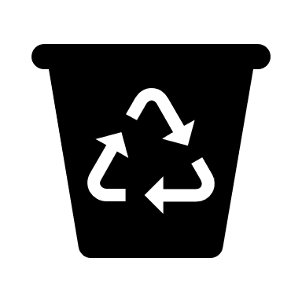

Slide 3
Environment and Responsibility
Disposed pads often end up in the oceans of the world.
Massive impact that this product has on the environment and eventually on communities
Now an increasingly vocal demand that the manufacturers of sanitary napkins assume more responsibility for the entire life-cycle of their highly-profitable product
Including where their products go after sale, and how and where they are eventually disposed

Slide 4
Rules and Regulations contd…
USEPA also classifies these under Medical Waste and recommends incineration in special facilities meant for treatment of medical waste
Australia - Australian / New Zealand Standard AS/NZS 3816:1998 Management of clinical and related wastes and any subsequent revisions classify these as medical waste and recommend incineration or sewage treatment
In UK, Waste 22 recommends that “Disposal of Offensive/hygiene waste may be recycled, incinerated (including energy from waste facilities) or landfilled in suitably permitted/licensed facilities.
In Japan, collection on specific days in the week and incineration of the hygiene products

Slide 5
Application of SWM Rules 2016
Rule 2
These rules shall apply to every urban local body, outgrowths in urban agglomerations, census towns as declared by the Registrar General and Census Commissioner of India, notified areas, notified industrial townships, areas under the control of Indian Railways, airports, airbases, Ports and harbours, defence establishments, special economic zones, State and Central government organisations, places of pilgrims, religious and historical importance as may be notified by respective State government from time to time and to every domestic, institutional, commercial and any other non residential solid waste generator situated in the areas except industrial waste, hazardous waste, hazardous chemicals, bio medical wastes, e-waste, lead acid batteries and radio-active waste, that are covered under separate rules framed under the Environment (Protection) Act, 1986.

Slide 6
Definitions in SWM Rules 2016
"solid waste" means and includes solid or semi-solid domestic waste, sanitary waste, commercial waste, institutional waste, catering and market waste and other non residential wastes, street sweepings, silt removed or collected from the surface drains, horticulture waste, agriculture and dairy waste, treated bio-medical waste excluding industrial waste, bio-medical waste and e-waste, battery waste, radio-active waste generated in the area under the local authorities and other entities mentioned in rule 2;

Slide 7
Definitions regarding Sanitary waste in SWM Rules 2016
“sanitary waste” means wastes comprising of used diapers, sanitary towels or napkins, tampons, condoms, incontinence sheets and any other similar waste;
"segregation" means sorting and separate storage of various components of solid waste namely biodegradable wastes including agriculture and dairy waste, non biodegradable wastes including recyclable waste, nonrecyclable combustible waste, sanitary waste and non recyclable inert waste, domestic hazardous wastes, and construction and demolition wastes;

Slide 8
Duties and responsibilities of local authorities and village Panchayats
Duties and responsibilities of local authorities and village Panchayats of census towns and urban agglomerations.- The local authorities and Panchayats shall,-
ensure that the operator of a facility provides personal protection equipment including uniform, fluorescent jacket, hand gloves, raincoats, appropriate foot wear and masks to all workers handling solid waste and the same are used by the workforce;
create public awareness through information, education and communication campaign and educate the waste generators on the following; namely:
  practice segregation of waste into bio–degradable, non-biodegradable (recyclable and combustible), sanitary waste and domestic hazardous wastes at source;
  wrap securely used sanitary waste as and when generated in the pouches provided by the brand owners or a suitable wrapping as prescribed by the local body and place the same in the bin meant for nonbiodegradable waste

Slide 9
No mention of what should be done with the sanitary waste collected along with
Non-biodegradable waste, only about DWH
The State Pollution Control Board or the Pollution Control Committee may give directions to local bodies for safe handling and disposal of domestic hazardous waste deposited by the waste generators at hazardous waste deposition facilities.
The operator of the facility shall be responsible for the safe and environmentally sound operations of the solid waste processing and or treatment facilities as per the guidelines issued by the Central Pollution Control Board from time to time and the Manual on Municipal Solid Waste Management published by the Ministry of Urban Development and updated from time to time.

Slide 10
Duty of manufacturers or brand owners of disposable products and sanitary napkins and diapers
Manufacturers or brand owners or marketing companies of sanitary napkins and diapers shall explore the possibility of using all recyclable materials in their products or they shall provide a pouch or wrapper for disposal of each napkin or diapers along with the packet of their sanitary products.
The biomedical waste shall be disposed of in accordance with the Bio-medical Waste Management Rules, 2016, as amended from time to time . The hazardous waste shall be managed in accordance with the Hazardous and Other Wastes (Management and Transboundary Movement) Rules, 2016, as amended from time to time. The Ewaste shall be managed in accordance with the e-Waste (Management ) Rules, 2016 as amended from time to time.

Slide 11
Waste Managers’ woes
12 billion pads or some say 432 million soiled pads (at 12% usage) of mixed cotton+wood pulp fibre/plastic to be safely disposed of every month
Contamination of water bodies, blocking sewer lines, adding more non-biodegradable waste to landfills
Posing an occupational hazard to those who handle solid waste, often with bare hands

Slide 12
Alternatives?
Washable cloth pads require water and soap – not always easily available
Since most of the washing in low income settlements takes place at a communal tap or hand pump, it is unlikely that women will wash their used cloth pads there

Slide 13


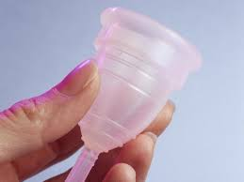
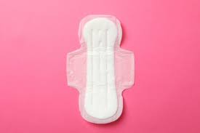
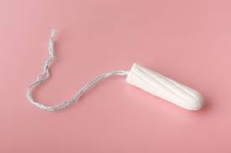
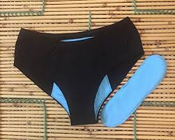
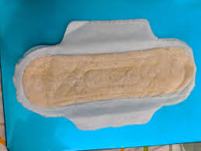
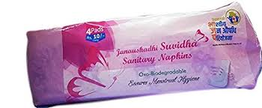
Menstrual Products in India
Reusable Products
Single Use Disposable Products

Slide 14
Single Use Disposable Sanitary Products in India
 | Cotton Napkin | Commercial Sanitary Napkin | Compostable Sanitary Napkin | Biodegradable Sanitary Napkin | Oxy-degradable Sanitary Napkin | Commercial Tampon | Organic Cotton Tampon
Type of Product | Absorbent | Absorbent | Absorbent | Absorbent | Absorbent | Absorbent | Absorbent
Content | Cotton | Cellulose, Super Absorbent Polymer, cotton, spunlace, polyethylene | Bioplastic with bio-SAP | Banana fibre/bamboo fibre/ water-hyacinth based napkins | Biodegradable additive, cellulose, spunlace, polyethylene | Cotton, Rayon, Polyethylene,Polypropylene | Organic Cotton
Disposal by User | Wrap in newspaper or its pouch and give in Dry waste Bin | Wrap in newspaper or its pouch and give in Dry waste Bin | Wrap in newspaper or its pouch and give in Dry waste Bin | Wrap in newspaper or its pouch and give in Dry waste Bin | Wrap in newspaper or its pouch and give in Dry waste Bin | Wrap in newspaper or its pouch and give in Dry waste Bin | Wrap in newspaper or its pouch and give in Dry waste Bin
Management as per Sanitary Waste Management rules 2016 | Deep Burial/Incineration | Incineration | Composting/Deep Burial | Deep Burial | Incineration* | Incineration | Deep Burial/Incineration
*For these products, disposal is not mentioned in the Sanitary Waste Management 2016 Rules, but the said method is recommended by the manufacturer

Slide 15
Reusable Sanitary Products in India
 | Cotton Cloth Pad | Layered Cloth Pad | Period Panty | Menstrual Cup
Type of Product | Absorbent | Absorbent | Absorbent | Receptacle
Content | Cotton | Cotton with Polyurethane laminate | Cotton with spandex | Medical Grade Silicon
Disposal by User | Domestic Hazardous Waste Bin | Domestic Hazardous Waste Bin | Domestic Hazardous Waste Bin | Domestic Hazardous Waste Bin
Management as per Sanitary Waste Management rules 2016 | Deep Burial/Incineration | Deep Burial/Incineration after removal of plastic layer* | Deep Burial/ Incineration* | Incineration*
*For these products, disposal is not mentioned in the Sanitary Waste Management 2016 Rules, but the said method is recommended by the manufacturer

Slide 17
Wrap securely the used sanitary waste like diapers, sanitary pads etc., in the pouches provided by the manufacturers or brand owners of these products or in a suitable wrapping material as instructed by the local authorities and shall place the same in the bin meant for dry waste or non- bio-degradable waste;

Slide 18
Non-degradability
Absorbent core – chlorine bleached wood or cotton pulp
Polyacrylate gel which soaks up the liquid quickly and holds in a suspension
The cover stock used is polypropylene non-woven, with the leak-proof barrier made from polyethylene film.
Over 90% of a sanitary pad is made of crude oil plastic; the rest is made from chlorine-bleached wood/cotton pulp.
We are rightly concerned about the billions of plastic shopping bags given away daily, but by using plastic-laden feminine hygiene products
Each year we add the equivalent of hundreds of billion plastic bags to our waste stream

Slide 19
A burning issue
The government schemes mention the installation of dedicated incinerators etc. in schools and communities
Given the poor track-record that we have in India of maintaining technology in effective working condition, small incinerators will be dangerous
It is safe to say that most of the sanitary napkins used will continue to find their way, in increasing numbers, into the solid waste collection system

Slide 20
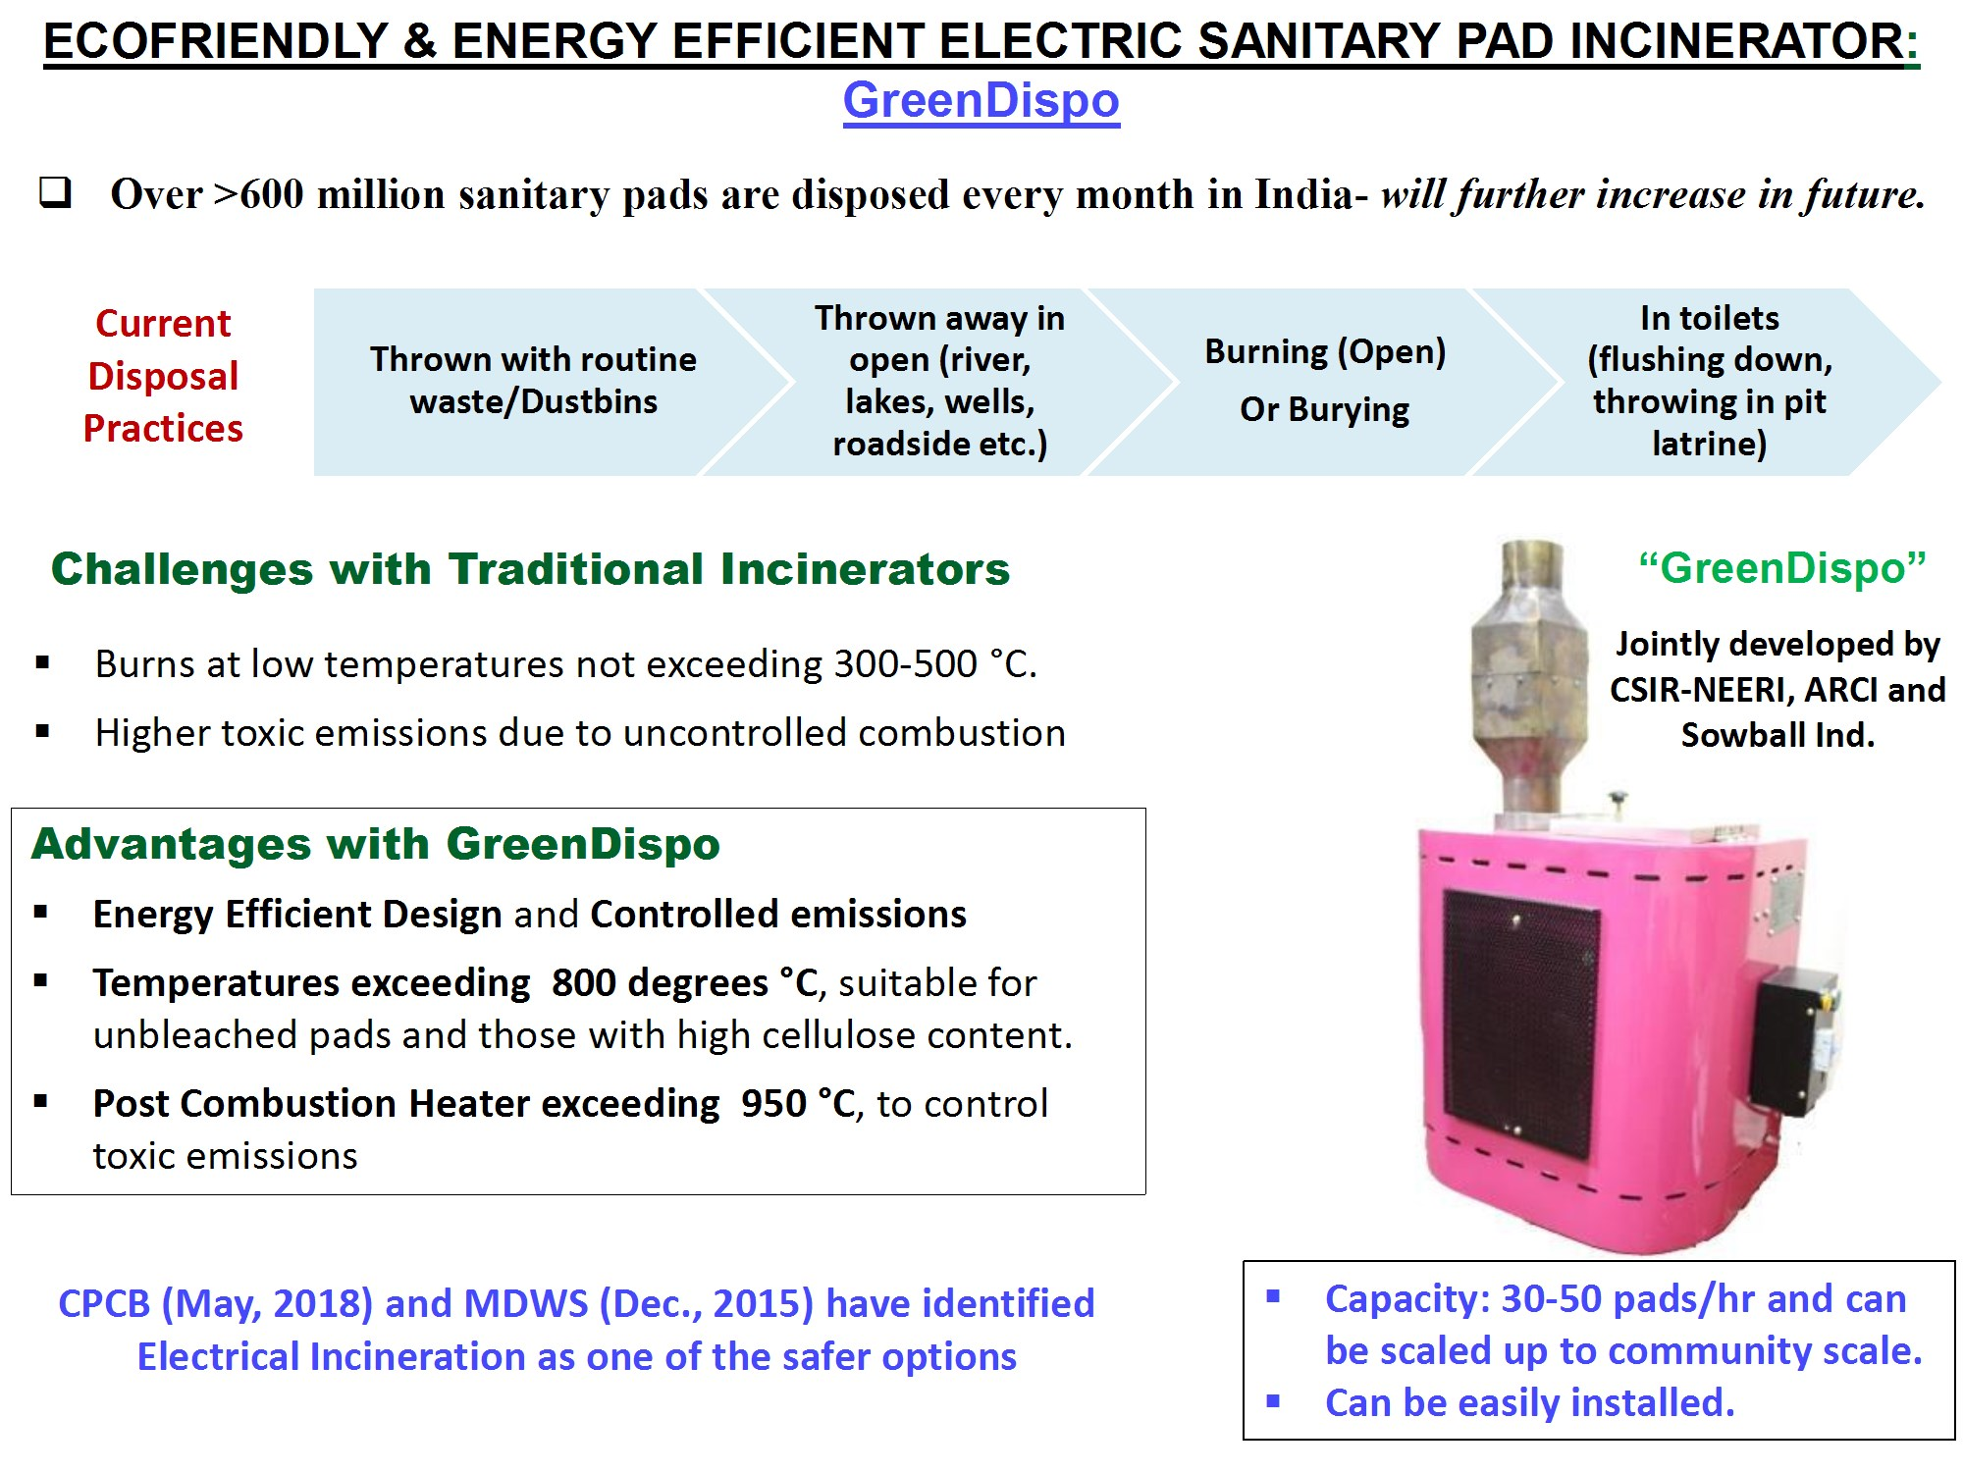

Slide 21
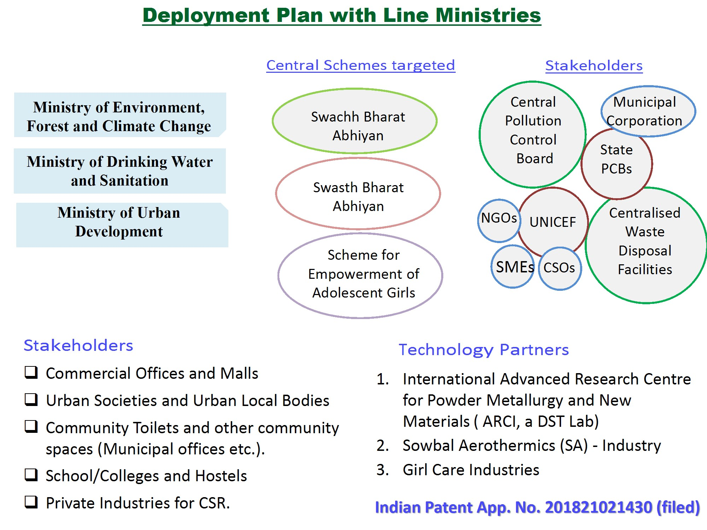

Slide 22
Health issues of waste workers
Waste pickers often cut themselves on broken glass and sharp pieces of metal that have been disposed in the general waste and have open wounds on their hands.
In this situation, soiled sanitary napkins and diapers are not just offensive to handle, but can actually be dangerous to the health –infection with Hepatitis/ Tetanus/ HIV/ E.coli/ Salmonella/ Staphyllococus, would be a very real possibility.

Slide 23
Management issues
Newspaper bags for used diapers and napkins but how are they ultimately disposed
Cloth napkins which are washable – not everyone
The producers are required to finance, and organize a system for environmentally sound management of waste generated from their products.
The concept of EPR has been adopted as being practised in various countries, requiring the producers to take responsibility for the end of life of their products and to ensure that the waste from such products is channelised for safe handling

Slide 24
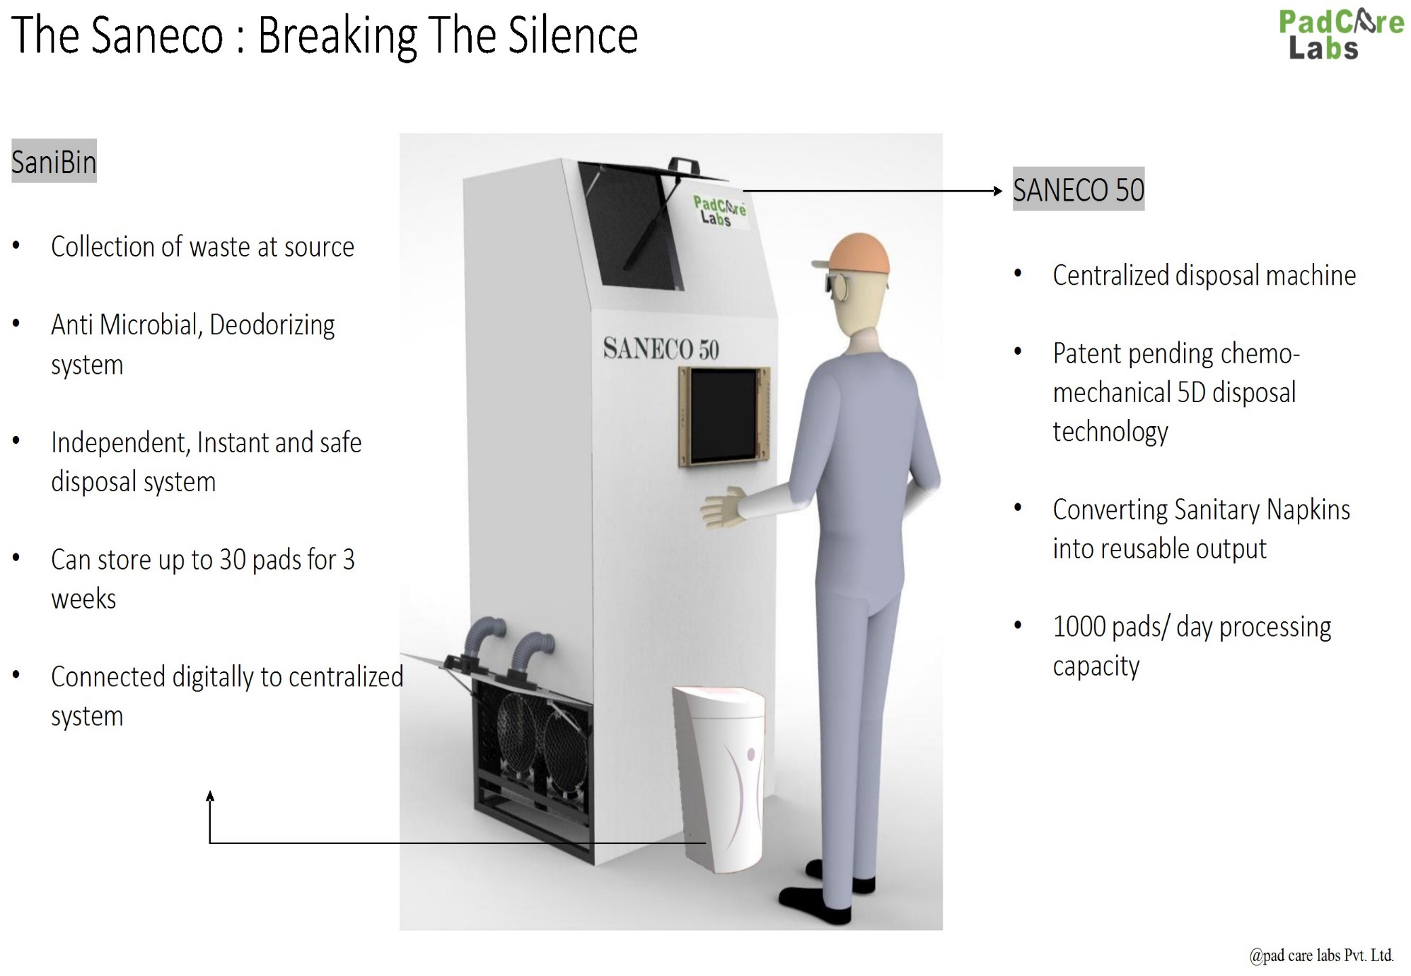

Slide 25
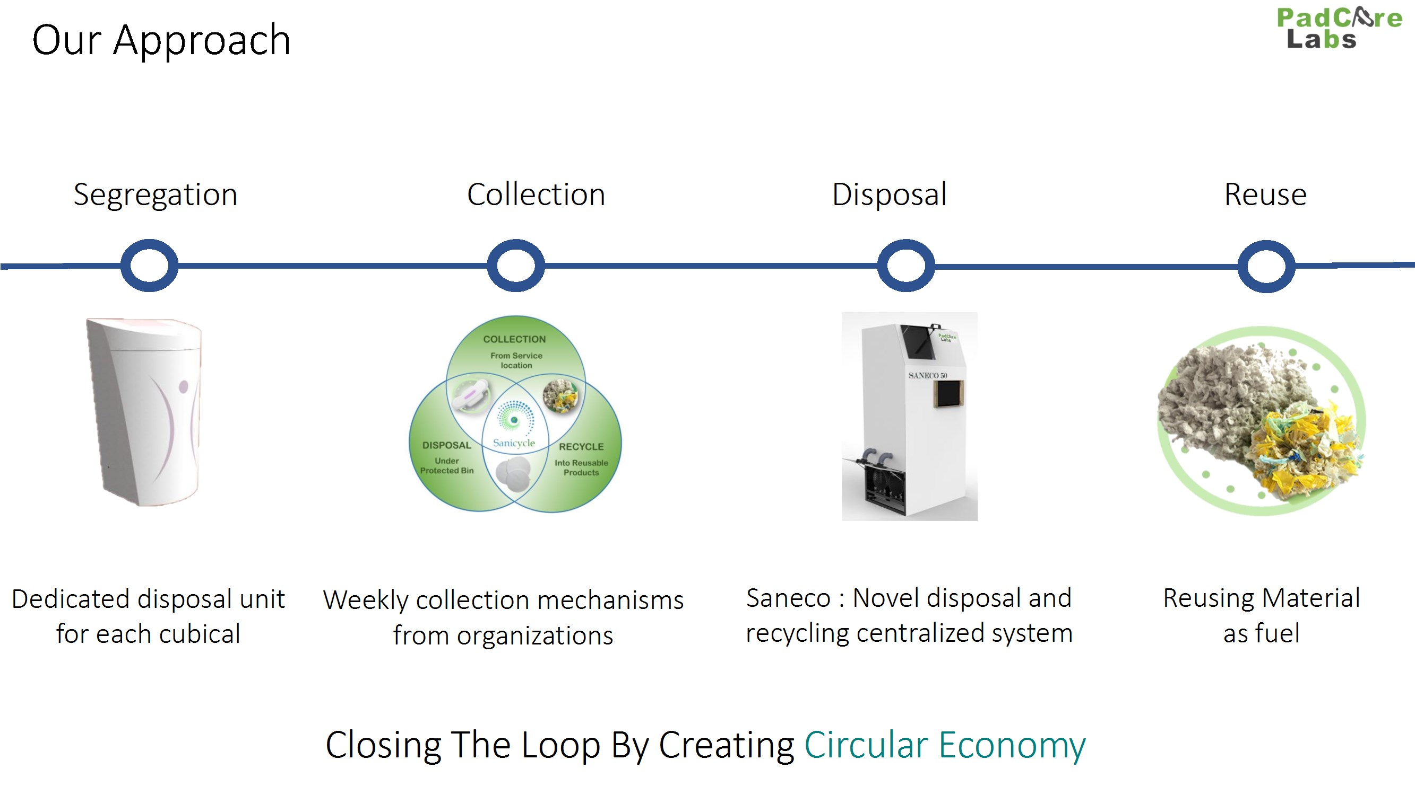

Slide 26
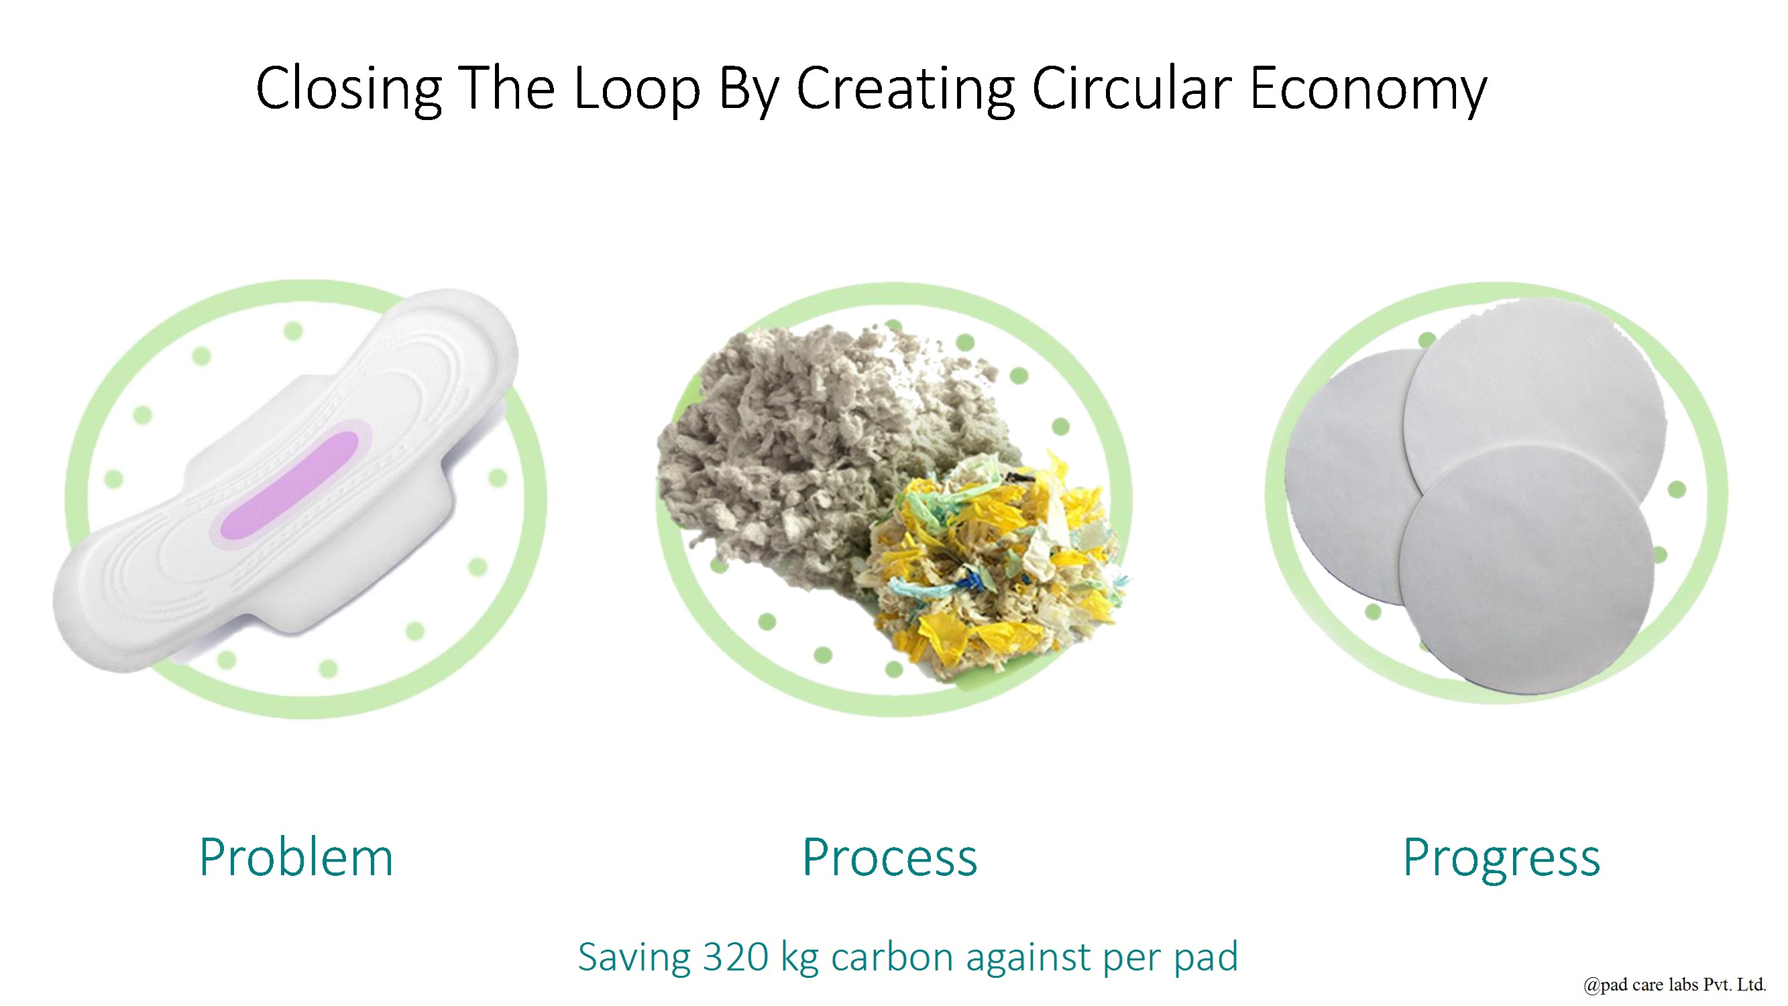

Slide 27
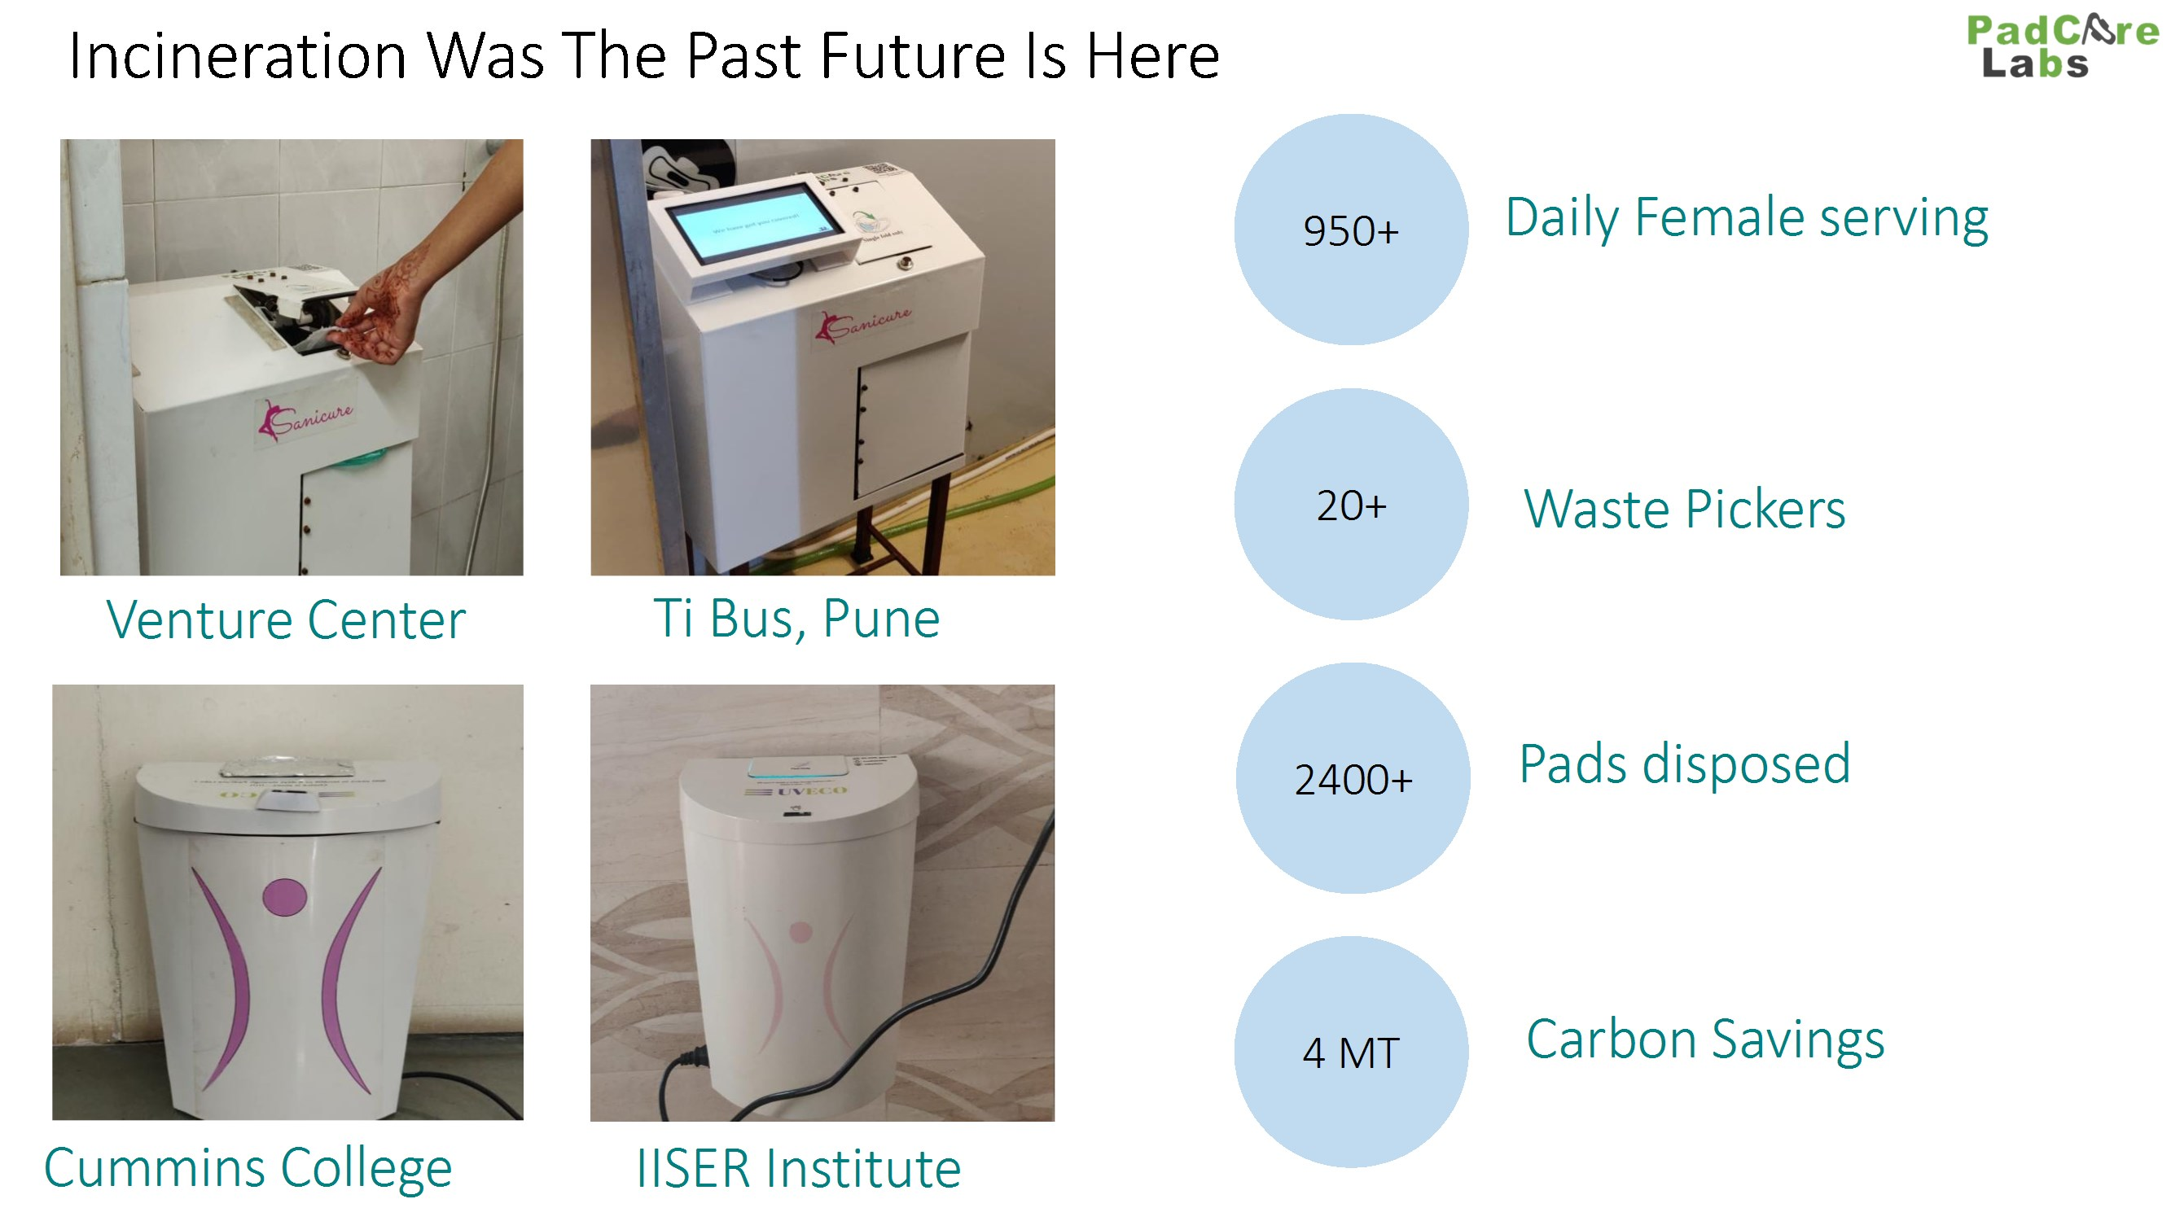

Slide 28
In rural and urban areas especially Class II, III, IV and census towns we recommend
Manufacture and distribution of STs which are totally degradable including all its components
Identification of land and construction of deep burial pits with proper specs as per BMWM Rules 1998 and its implementation guidelines
Deep burial of used degradable STs, diapers etc. and proper maintenance of pits/ constructed structures (in states with high water table, the entire structure would have to be over-ground) through addition of lime etc.

Slide 29
In Class I cities and towns
Collection of HH hygiene products on specific days in the week through organized collection
Tie up with biomedical waste collectors and CTF operators for pick up at various locations for treating the above in regular CBWTFs
Cost calculation for collection, transportation and treatment and cost recovery mechanisms

Slide 30
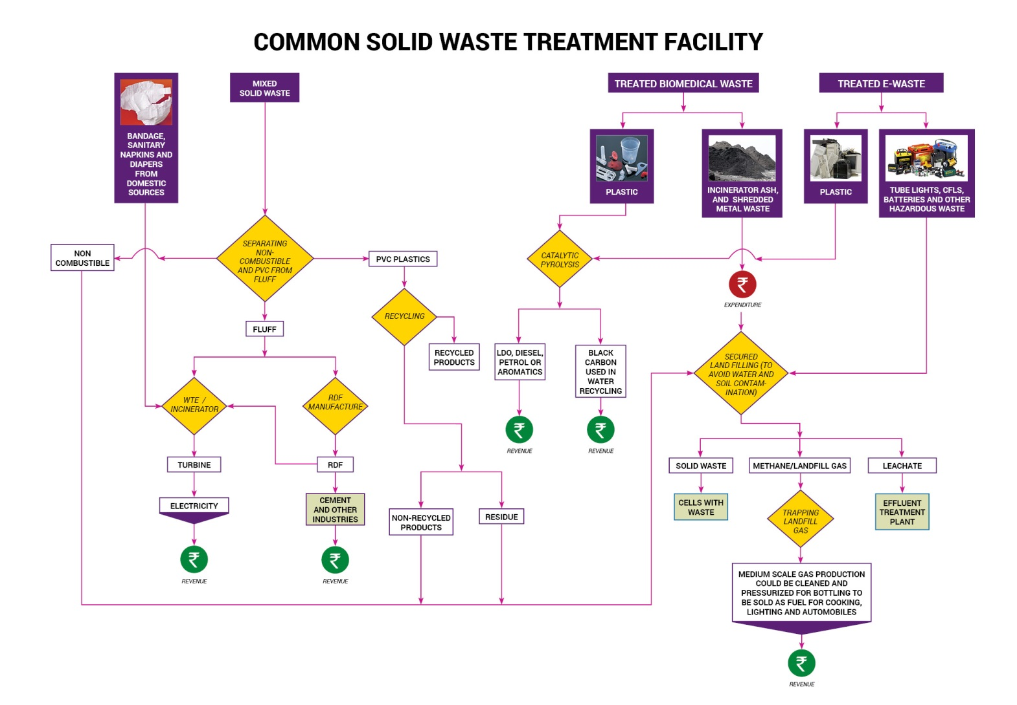

Slide 31
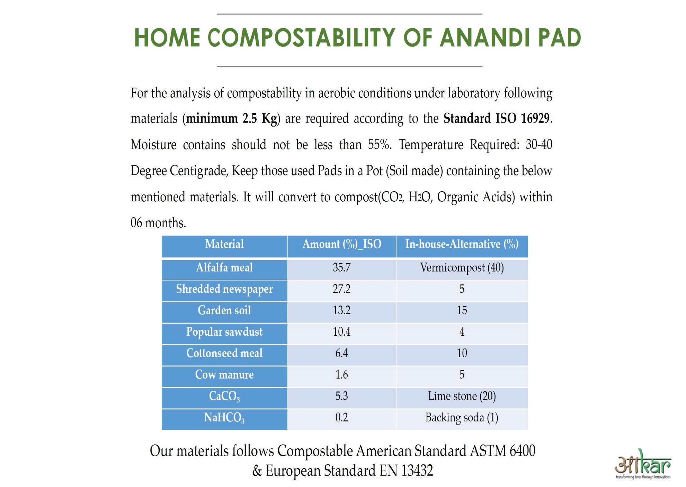

Slide 32
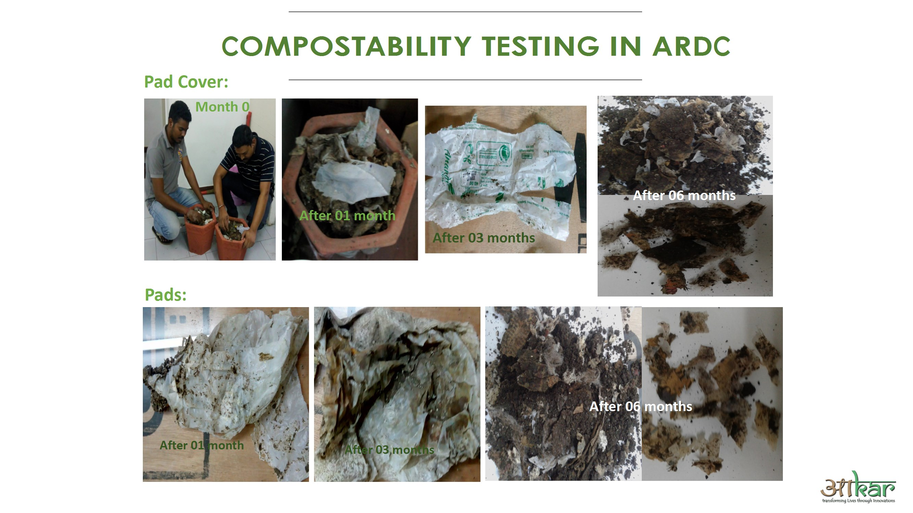

Slide 33
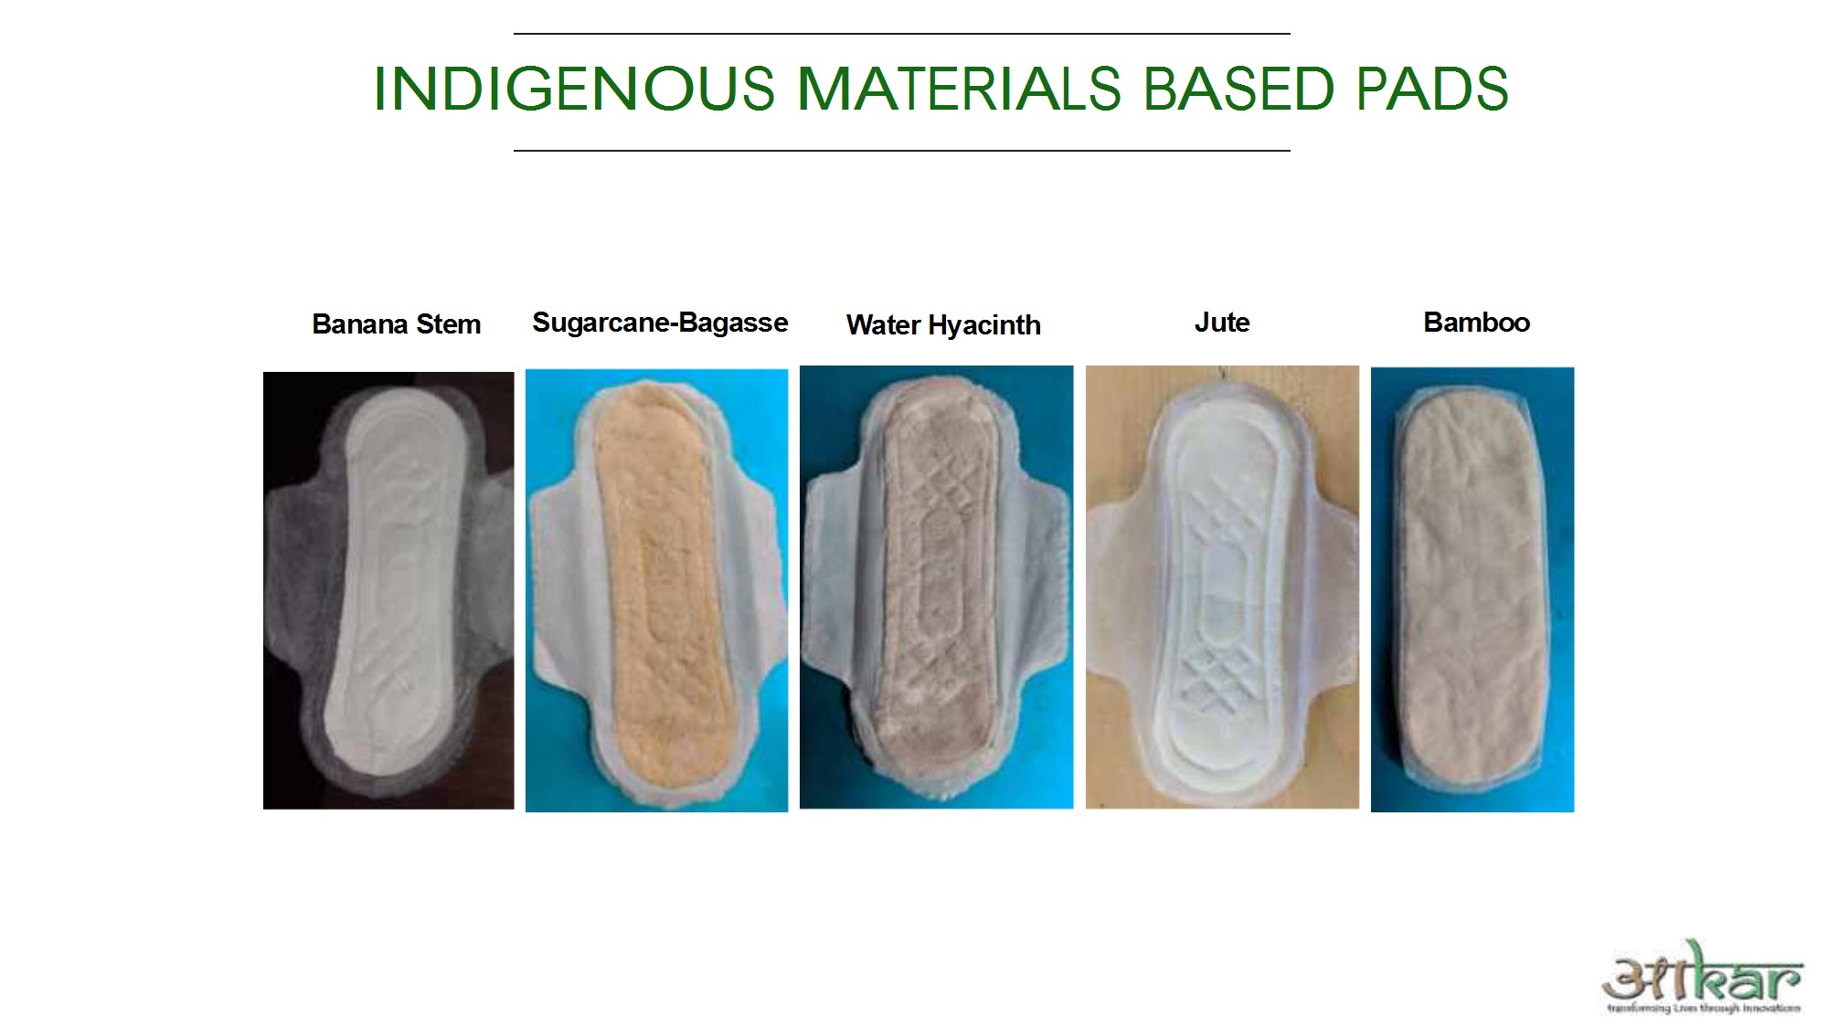

Slide 34
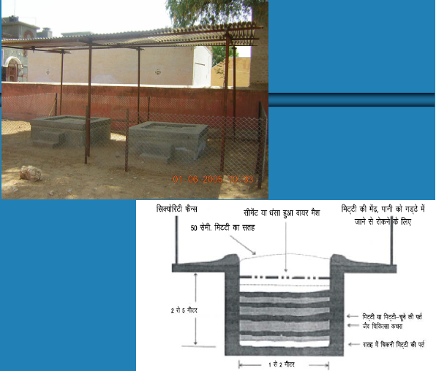
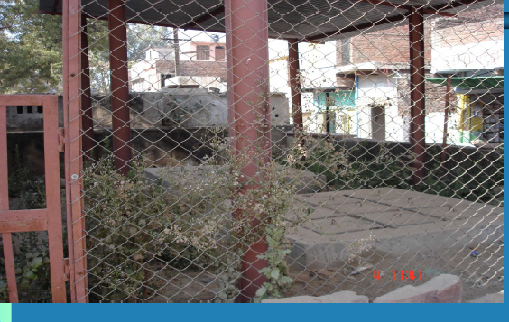
Is Deep burial in rural areas in India possible, if the ST is completely degradable?

Slide 35
Thank you
shyamala.mani@gmail.com

