Slide 1
“ACCESS FOR ALL: SUPPLYING A NEW DECADE FOR REPRODUCTIVE HEALTH ” Country Ownership of Reproductive Health; An NGO Perspective
Dr. Reena Yasmin, Marie Stopes Bangladesh

Slide 2
NGOs: Can they take
“Country Ownership”
Work with goals & objectives that matches national priorities
Flexibility in designing and implementing programmes
Reaching the underserved and vulnerable, in difficult & remotest locations
NGO resources can be mobilized in constraint situations

Slide 3
NGOs as service providers
Social Marketing
Source: BDHS 2007; Bangladesh

Slide 4
Govt Projection Vs Achievement
2001 - 2010
Roving Team activity of MSB started in 2007

Slide 5
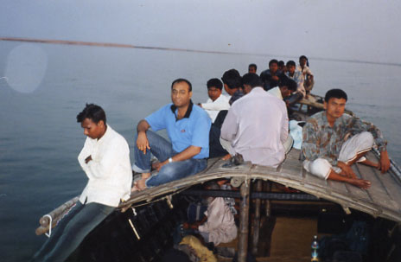
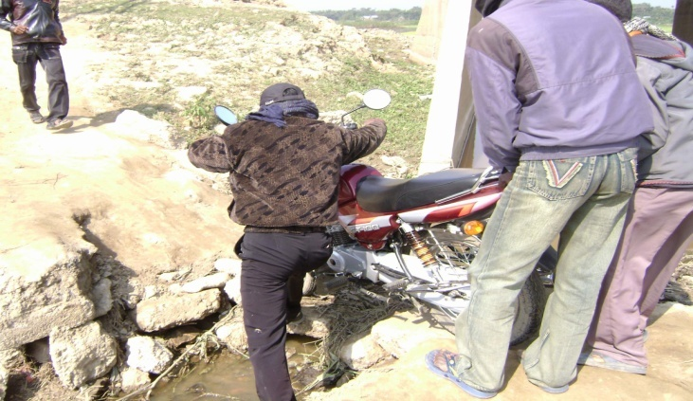
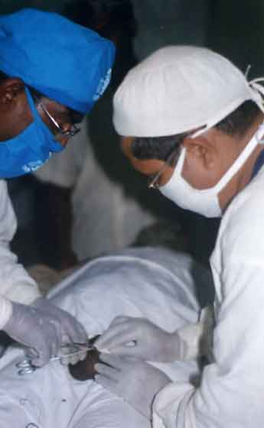
Reaching marginalised groups
ROVING TEAM: Addressing remote & underserved areas
Low performance
Lack of skilled manpower
High absenteeism of service providers
Inadequate financial allocation

Slide 6
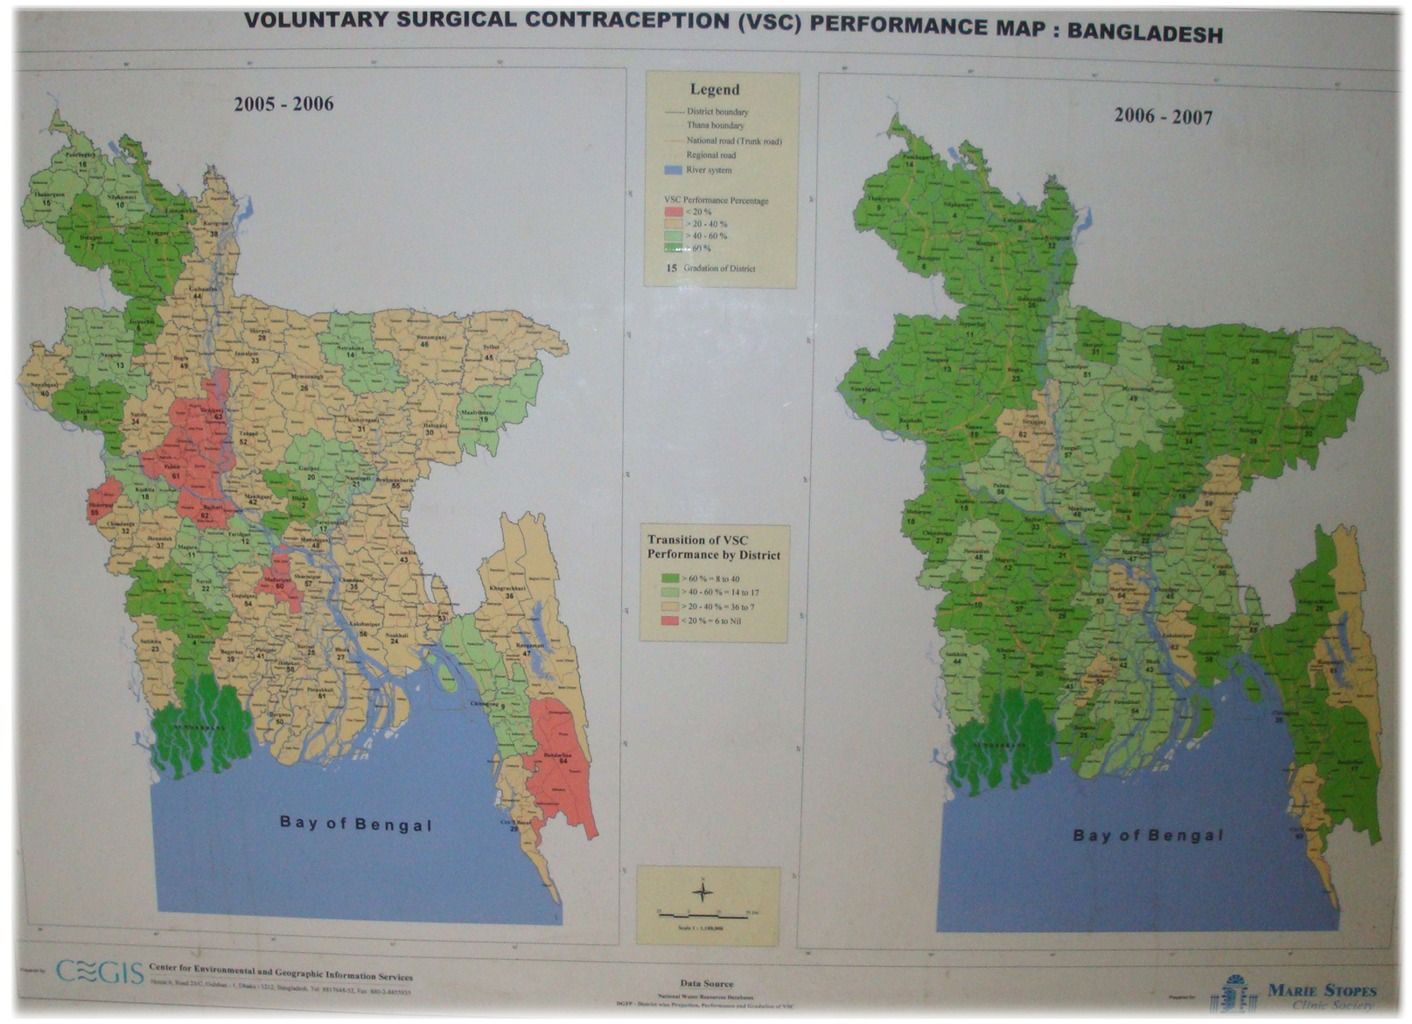
Impact of Roving Team Activities

Slide 7
Sharing Ownership
as direct health care providers,
as innovators in diversifying modalities of health care delivery,
in training formal and informal health service providers,
in research and development,
work as catalyst/facilitator for creating demand for services and linking community with health/FP facilities, and
Establishing accountability for its interventions through raising community and civil society voices

Slide 8
Taking Ownership
Minimum ownership: Government exchanges information with the NGO to ensure that the services are directed where they are needed most and overlap with public services and other NGOs is minimised
Maximum ownership: Government contracts the NGO to deliver services
Sustainable ownership:
Involving NGOs in relevant policy guidelines & operational planning
Ensuring efficient use of donor/pool funding for NGO contracting
Involving NGOs in development of Country Action Plan
Building capacity of the NGOs and expand training opportunities for public, private & NGO sectors

Slide 9
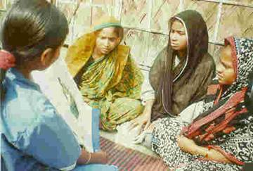
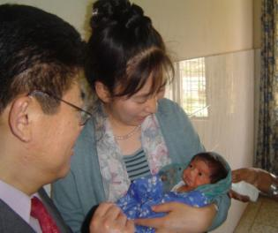
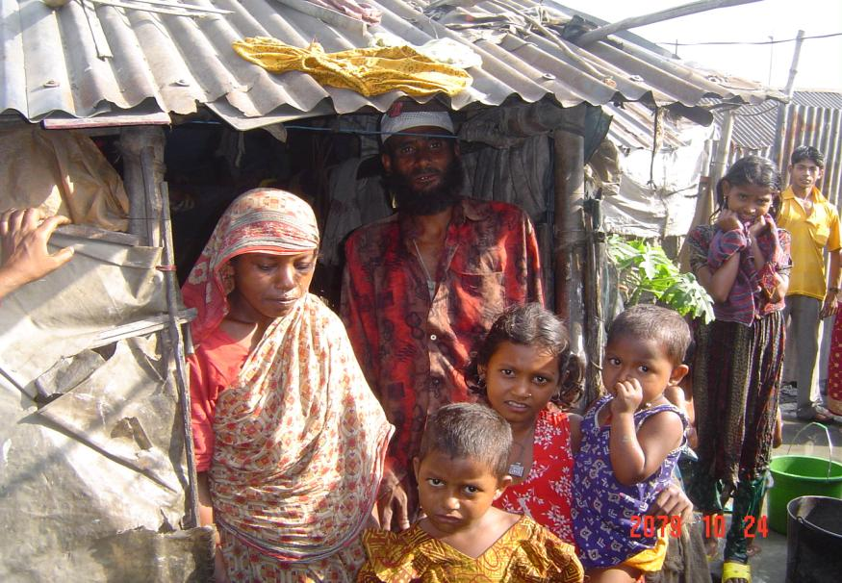
NGO contracting
SECOND URBAN PRIMARY HEALTH CARE PROJECT
UPHCP has increased access to services by the poor in Bangladesh
Progressive increase in client flow; on an average from 60,000 per month in 2005 to around 250,000 in 2010
Progressive increase in institutional delivery; on an average from 72 deliveries per month in 2005 to more than 300 in 2010
The successful model of PPP

Slide 10
Catalysing others; private sector
Why work with private sector?
As the economy continues to grow so will the private health sector
Despite this growth, the private sector is still an insignificant provider of LAPMs,
is often a person’s first point of contact with the health system – especially pharmacies
Challenges:
Low or unpredictable quality of private sector providers
User-fees as barrier to access
Ways of working:
Voucher scheme
Social Franchise

Slide 11
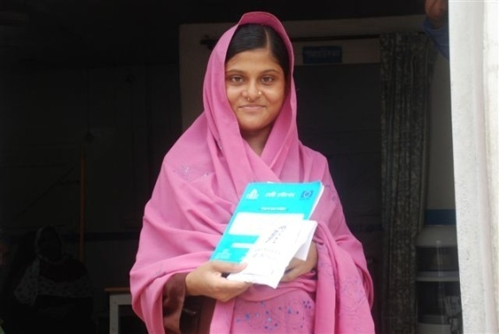
Voucher scheme
Facilitate increased access to and utilization of
services by the poor
Empower poor women to procure quality services
from qualified service providers
Create a demand for services
Improve quality of care
Vouchers can be for specific, under-provided services
Vouchers can overcome user-fee barrier to access
Private providers have to improve quality to get accredited and to remain in the scheme and have to maintain quality to compete with other providers
So vouchers fill gaps and provide a low-resource means of improving quality in the private sector

Slide 12
Social franchise
The Blue Star Programme
Around 150 graduate doctors and 3,220 non-graduate medical practitioners were dispensing injectable contraceptive under the Blue Star Programme
7% of the eligible couples are using injectable contraceptives compared to 2.6% in 1991
Since 1999 the consumption of injectables has grown from 8,500 to about one million in 2009.
Social Franchising can cover any range of services
Services can be taken closer to the community overcoming transportation barrier to access
Social franchising acts as the vehicle for maximizing service utilization

Slide 13
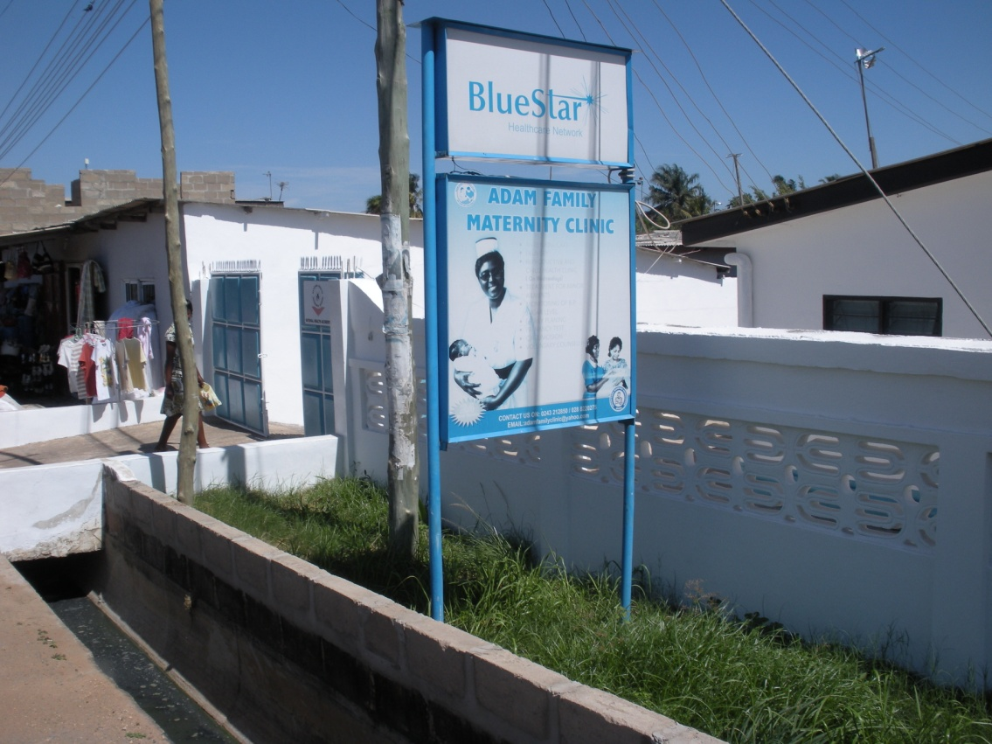
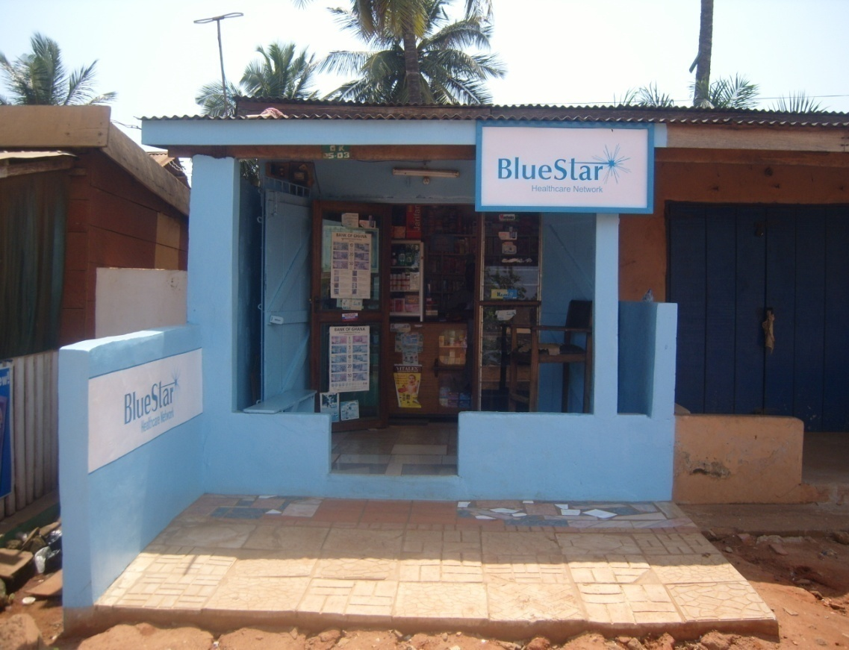
Notes:
13

Slide 14
Management Agency Functions
accreditation,
training,
voucher distribution and marketing,
behaviour change communication,
quality assurance,
claims management and provider reimbursement,
monitoring and evaluation,
fraud control

Slide 15
Taking ownership
Short-term
Chair or participate in the oversight committee to whom the management agency reports,
Co-ordinate national coverage by directing voucher/franchise efforts to regions most in need of additional family planning service providers,
Integrate state-run clinics into the schemes
Medium-term
Take responsibility for contracting the management agency,
Take responsibility for accrediting service providers to participate in the scheme
Take responsibility for monitoring and evaluation
Financing the reimbursing of the service providers through the management agency, possibly using budget support and Health SWAp resources.
Long-term
Taking on some or all of the management agency’s functions,
Replacing some or all of the programme with a health insurance scheme incorporating the already accredited service providers and reimbursement rates.

Slide 16
Conclusions
Contract NGOs to fill key gaps in national service delivery
Engage with NGO voucher and Social Franchise Schemes as a stepping stone to more comprehensive ‘ownership’ of the private sector
Utilize NGO capacity, innovations and flexibility to maximize outcome

