Slide 1
Quality of Emergency Contraceptive Pills:
Should we worry?
Elizabeth Westley, ICEC Coordinator
Reproductive Health Supplies Coalition Membership Meeting
Addis Ababa, June 24th
Notes:
1
Good morning, ladies and gentlemen.
My name is Elizabeth Westley, and I coordinate the International Consortium for Emergency Contraception, which is an interagency consortium housed at Family Care International, in New York. ICEC brings together around 30 international agencies and about one thousand, two hundred individuals. I will describe our work more fully later this morning.
Thank you to the Market Development Approaches Working Group for inviting me to be a part of this panel.
First of all, I would like to say that ONLY in Allegorica would you find 50% of the EC products on the market are fakes. Luckily, Allegorica is not real. However, the issue of quality is real, as I will describe.

Slide 2
Key Points
Current situation re: EC market.
Clarify language: difference between counterfeits and unknown quality.
Approaches for counterfeits.
Approaches for drugs of unknown quality.
“IMHO”
Notes:
I’m going to start off letting you all know what I’m going to cover here today. I want to lay out some of the issues that have been raised at our annual Consortium meetings since 2008. I want to clarify the language that we are using, because I’ve noticed this week that we are not all working from the same definitions. And I’m going to humbly – very humbly – suggest some possible ways forward.

Slide 3
Levonorgestrel Emergency Contraceptive Pills
Also known as the “morning after pill,”
Taken after intercourse to prevent pregnancy.
Older, off-patent hormone.
Widely used in combined oral contraceptives.
Excellent safety profile, decades of use.
Relatively low cost
Notes:
I think most of you are familiar with emergency contraception, although some of you may know it as the “morning after pill.” For the purpose of this presentation, I will be talking about the dedicated EC pills, which are formulated with a single hormone, levonorgestrel.
For this presentation on quality, what is important is that levonorgestrel is an older, off-patent hormone, widely used in combined OCs. It has an excellent safety profile with many years of post-marketing surveillance in both OCs and EC. It is relatively low cost at least in terms of its raw ingredients.

Slide 4
Finding a Manufacturing Partner
Only one manufacturer – Gedeon Richter - initially willing to package LNG as ECPs.
Partnership between Gedeon Richter, WHO, and Concept Foundation on behalf of Consortium – expired in 2007.
Requirements: stringent regulatory approval, low price to public sector, collaboration on labeling.
Notes:
It is worth going back to 1996 when the Consortium was first established. Only one manufacturer was willing to partner with the Consortium to manufacture a dedicated EC product at that point, and that was the Hungarian company Gedeon Richter, that was already selling levonorgestrel-alone products, although not packaged for EC.
A partnership was forged between Gedeon Richter, WHO and the Concept Foundation on behalf of the Consortium, to bring a dedicated EC product to market. It was required that the manufacturer be able to meet stringent regulatory approval, provide a low price to the public sector, and collaborate on labeling and some other issues. The manufacturer also donated some product to some start up projects in certain countries.

Slide 5
Fast Forward: 2011
ICEC database lists 81 separate manufacturers of LNG ECPs.
Women tend to obtain EC at pharmacies, not clinics.
Commercial sector very strong, very interested in EC.
Notes:
Now I am going to fast forward to now. At this time, instead of one manufacturer of a product with stringent regulatory approval, we have many manufacturers and many products – approximately 81 separately manufacturers.
We also find that women tend to like to obtain EC at pharmacies, not at clinics, and the commercial sector has taken a very strong interest in meeting women’s demand for EC.

Slide 6
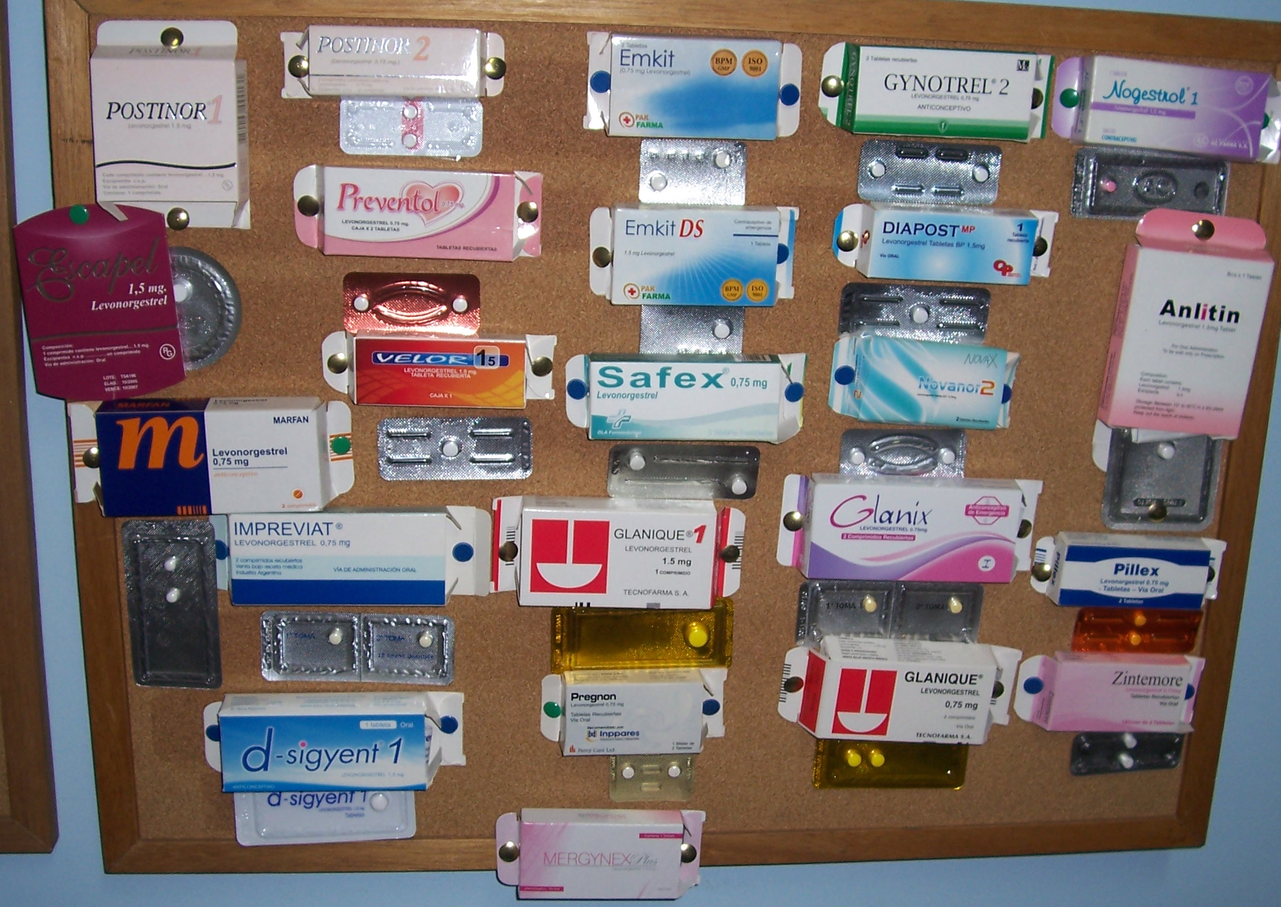
Notes:
These are products that were on the market in Peru in 2010. Peru has 42 products registered. Ethiopia, I believe, has two, and Kenya has 6. Mexico has 13 registered products, and China has about 35 as far as we can tell.

Slide 7
Looking on the bright side
Number of products registered has long been a metric of success.
The more products, the more access for women.
EC tends to be fairly expensive and more products might drive the price down.
Notes:
Peru is an extreme case, but in general, having so many products on the market is a good thing! We have long encouraged other manufacturers to join the EC field, as this generally expands access for women. More products might even drive prices down, although this doesn’t seem to be happening as far as we can see.
We do need to remember the importance of price, not only to procurers, but also to individual women. We hear anecdotally a lot that women find the dedicated product unaffordable; some providers are even going back to the Yuzpe regimen, made of regular oral contraceptives, for this reason. When we ran a two week online forum on EC with WHO a couple of months ago, cost was the issue that was raised the most frequently by our contributors.

Slide 8
EC is a test case because it is a “successful” RH product
Profitable: Social marketing companies can usually sell it for full cost recovery.
Commercial sector very interested in EC market.
Relatively easy to manufacture, low cost.
Women like EC (when they know about it) and will pay out of pocket for it.

Slide 9
Three Streams of EC Products
Donor or government procured.
NGO/social marketing procured.
Pure commercial sector: regulated at the country level by local drug regulatory authority.
Notes:
So if we look at where women are obtaining EC (and other family planning methods), we find that EC is now available to women through three streams: donor or government procured, NGO or social marketing procured, and sold in the purely commercial sector. The first two streams, I would argue, are pretty similar, although some purchasers may have different requirements as regards where the product has been approved and so on.
We have heard from many of our presenters on Wednesday that the private sector, which includes the commercial sector, is growing and is playing a very important role in Africa and globally in meeting the family planning needs of women and men.

Slide 10
Quality of Products
Products in first two streams – donor/govt procured and NGO/social marketing procured – are of assured quality.
Some of the products in the commercial sector may be of unknown quality.
Where is our sphere of influence, especially for products that are not donor/NGO procured?
Notes:
Most of the conversation during this week has been about products in the first two streams – those procured by UNPFA, or USAID, or country governments, or social marketing agencies such as DKT and PSI and Marie Stopes. I would go so far as to say that these products are of assured quality. I would use them – in fact I have used them – don’t tell USAID, but I used to buy a lot of oral contraceptives at a small shop in Kintampo in Central Ghana. I knew they were good because of the handshake logo, and they cost only one dollar per cycle.
Several times this week we have heard about the large percentage of FP and health services provided by the private and commercial sectors. Products in the commercial sector may in some cases be of unknown quality.
It is important for us to think carefully about where we in the global reproductive health community might have influence.

Slide 11
Counterfeiting
Two separate issues related to quality: counterfeit and substandard drugs.
VERY DIFFERENT ISSUES!
Counterfeited products have been reported by manufacturers in some markets but are unlikely to be a major problem (yet).
Notes:
Now I’m going to get to that provocative word that is in the title of this panel – FAKES.
There are two distinct problems related to quality in the third “commercial” stream of products. These are the issue of counterfeit drugs, and of sub-standard drugs. These are two very different issues that require very different approaches.
Our manufacturing partners have noted some problems with counterfeiting in a few markets, but we are not yet at the stage that they were in Allegorica, where they found 50% of their EC drugs were fakes.

Slide 12
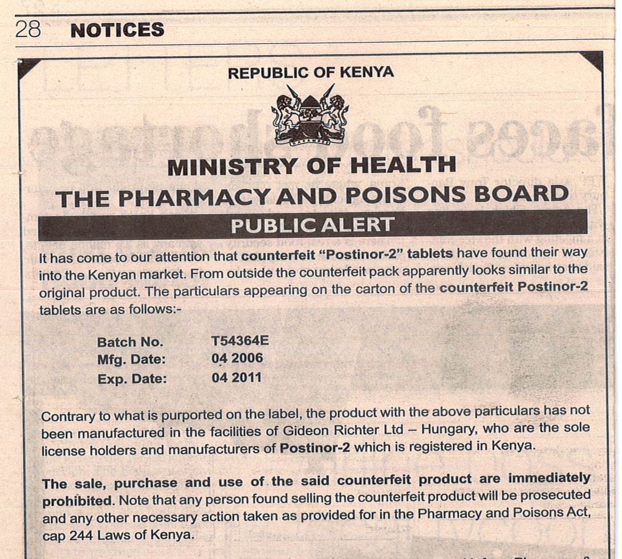
Notes:
Here is a notice about fake Postinor on the market in Kenya.
Fakes usually contain no active ingredient and are sold with mal-intent – that is, they are really criminal.

Slide 13
Notes:
As these documents show, it is the manufacturers responsibility to deal with counterfeiting, and it can be quite expensive and a lot of work. Here you see the new packaging for Postinor in Kenya, replacing the familiar pink box with the red rose that we saw in the Peru slide.

Slide 14
What to do about fakes?
At this point fakes do not seem to be a major problem for RH drugs.
Responsibility lies with:
Manufacturers
Country drug regulatory agencies – can they be strengthened?
Global anti-counterfeiting efforts currently focused on anti-malarials, ARVs – can we persuade them to add RH drugs to their remit?
Notes:
At this point in time, I would propose that the only reproductive health drug with a counterfeiting problem is VIAGRA. However, we do have to be vigilant. Our manufacturers need to act aggressively and transparently if they find fakes.
I would also propose that we not try to “own” this problem in the reproductive health field. There are major efforts involving numerous global and national agencies, aimed at fighting counterfeit drugs, which are often connected to other criminal enterprises. I wonder if anyone has any suggestions for how we might get RH products added to the list of drugs that are currently being monitored for counterfeiting?

Slide 15
Drugs of unknown quality
Legitimately registered in the country of sale.
Intended to work as the “innovative” drug but may be manufactured in a less controlled environment.
Some costs may be cut for profit: may have inadequate active pharmaceutical ingredient (API).
May not be bio-equivalent to innovative drug as regards dissolution and other tests.
Notes:
We believe that probably none of the drugs in the Peru slide are counterfeits. However, quite a few of them are of unknown quality and some may be of sub-standard quality. This is a little harder to figure out than pure fakes, which from what we have heard usually contain no active ingredient whatsoever.
On the other hand, many drugs of unknown quality may in fact be intended to work just like the innovative product, but the quality control procedures may be inadequate, or as we have heard in the MDA working group meeting on Tuesday, the manufacturers may be skimping on the Active Pharmaceutical Ingredient (API) to save money.

Slide 16
What to do about drugs of unknown quality?
Strengthen national and regional regulatory and drug safety systems.
Market known-quality drugs as “value added.”
Don’t assume they are going to be ineffective – “unknown” does not need to mean “bad.”
Notes:
At this point in time, I would propose that the only reproductive health drug with a counterfeiting problem is VIAGRA. However, we do have to be vigilant. Our manufacturers need to act aggressively and transparently if they find fakes.
I would also propose that we not try to “own” this problem in the reproductive health field. There are major efforts involving numerous global and national agencies, aimed at fighting counterfeit drugs, which are often connected to other criminal enterprises. I wonder if anyone has any suggestions for how we might get RH products added to the list of drugs that are currently being monitored for counterfeiting?

Slide 17
QJB (Quick Joke Break)
Doctor, is it bad?
Not too bad, I can do the surgery under local anesthetic.
Local? Can’t you use imported?
Notes:
The point of this joke is that we as a community need to guard carefully against any potential bias against drugs from certain countries or certain markets, or indeed against generic drugs in general.

Slide 18
Why does ICEC care?
Our mission:
“To expand access to safe and locally appropriate EC with a focus on developing countries.”
Are all EC products equally safe and effective?
Notes:
As you can tell, I don’t have the answers to this quality question, so you may well ask – why are you talking about this? Well, I’m talking about it because this is an issue that our constituents raise as a concern. I also try to look at all issues through the lens of ICEC’s mission, and we want to make sure that every woman who accesses an EC product in any country of the world is getting a safe product.

Slide 19
When you find yourself in unfamiliar territory…
Notes:
In general, this area of drug quality is a new one for ICEC and I think new for many of us in the room. We are in unfamiliar territory. What to do?
Lake Shala, 1972

Slide 20
It may be time to
JUMP IN!
Notes:
I would propose that when faced with a perplexing problem, sometimes you just need to go for it.
Addis Ababa Hilton Hotel, 1972

Slide 21
ICEC Plans
One-day technical consultation in October 2011.
Possible product assessments?
ICEC supports RHSC efforts to address quality and calls for a shared vision and commitment to address the quality of RH products.
Notes:
ICEC plans to jump in by convening experts to discuss further in October. If we feel as a group that the situation warrants it, we may do some additional testing. And we support the efforts by the Reproductive Healthy Supplies Coalition, WHO and others to raise the issue of quality of Reproductive Health drugs. We also call on everyone in the room to commit to putting the issue of quality on your own organizational agendas. Many innovative ideas have been suggested here, including regionalization of drug regulation and harmonization of the major regulatory efforts.

Slide 22
Thank You!
www.emergencycontraception.org
http://my.ibpinitiative.org/ICEC
Notes:
22
Many thanks for your attention! The Consortium welcomes you to sign up for news and information about EC. Please see me and give me your business card, or you can visit us on the web at emergencycontraception.org, or join our IBP community, which you will find under “ICEC” in the IBP site.

